Slide 1
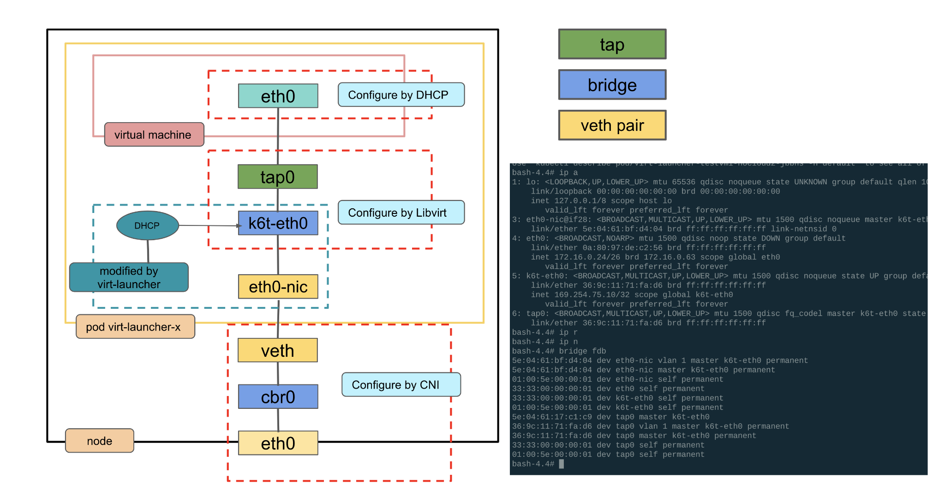

Slide 2
The Kubernetes NMState Operator

Slide 3
A centralized and declarative host network configuration tool in a Red Hat OpenShift cluster.
Reports the node network configuration, validates configuration syntax, and applies network configuration changes without a node reboot.
Configure additional node network devices, such as Linux bridges, and use them in network attachment definitions.

Slide 4
API resources: Managing the network configuration
NodeNetworkState
NodeNetworkConfigurationPolicy
NodeNetworkConfigurationEnactment

Slide 5
Node Network State
Node Network Configuration Policy
A node network state (NNS) resource exists on each cluster node and is periodically updated to include the state of the network for that node.
oc get nns/node-name -o yaml
A node network configuration policy (NNCP) describes the intended network configuration for OpenShift nodes
oc get nncp nncp-name -o yaml
Mark absent in state will remove interface from node.

Slide 6
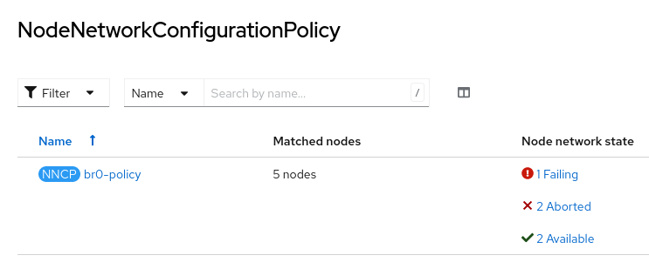
Node Network Configuration Enactment
NodeNetworkConfigurationEnactment (NNCE) object will generate for each cluster node that the policy affects by NNCP update
Reports the execution status of an applied policy and includes the defined settings that the policy enacts on each node.
In the event of a failure, the node rolls back to its prior configuration, and the NNCE provides traceback data to troubleshoot the failure.
oc get nnce nnce-name -o yaml

Slide 7
QEMU guest agent is responsible for collecting the IP addresses of the VM as well as display in webconsole.

